Slide 1


Slide 2

PROJECT OVERVIEW

Slide 3


PROJECT OVERVIEW
The objective of this case study is to predict the health insurance cost incurred by Individuals based on their age, gender, BMI, number of children, smoking habit and geo-location.
https://www.publicdomainpictures.net/en/view-image.php?image=279909&picture=medical-insurance

Slide 4
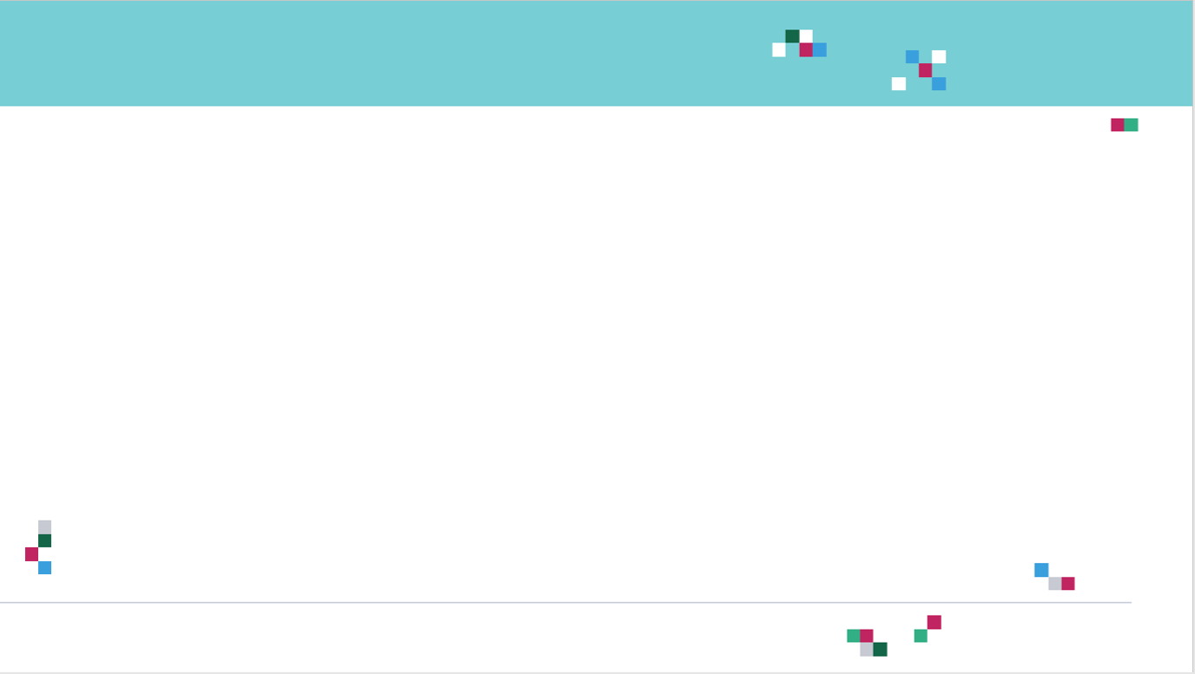
PROJECT OVERVIEW
The available features are:
sex: insurance contractor gender
bmi: Body mass index (ideally 18.5 to 24.9)
children: Number of children covered by health insurance / Number of dependents
smoker: Smoking
region: the beneficiary's residential area in the US, northeast, southeast, southwest, northwest.
Target (output):
charges: Individual medical costs billed by health insurance
Data Source: https://www.kaggle.com/mirichoi0218/insurance

Slide 5
MULTIPLE LINEAR REGRESSION

Slide 6

RECALL SIMPLE LINEAR REGRESSION?
Goal is to obtain a relationship (model) between two variables only such as age and insurance cost for example.
MODEL! (GOAL)
$$y=b+m∗x$$
INSURANCE COST ($)
DEPENDANT VARIABLE
INSURANCE PREMIUM ($)
INDEPENDENT VARIABLE
AGE (YEARS)
AGE (YEARS)

Slide 7
MULTIPLE LINEAR REGRESSION: INTUITION
Multiple Linear Regression: examines relationship between more than two variables.
Recall that Simple Linear regression is a statistical model that examines linear relationship between two variables only.
Each independent variable has its own corresponding coefficient.
$$y=b_{0}+b_{1}∗x_{1}+b_{2}∗x_{2}+..+b_{n}x_{n}$$
DEPENDANT VARIABLES
INSURANCE COST ($)
INDEPENDENT VARIABLES
(AGE, SMOKING HABITS, REGION,..ETC)

Slide 8
REGRESSION METRICS AND KPIs

Slide 9
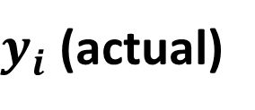

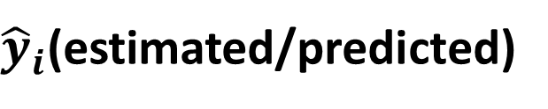
REGRESSION METRICS: HOW TO ASSESS MODEL PERFORMANCE?
After model fitting, we would like to assess the performance of the model by comparing model predictions to actual (True) data
$y_{i}$ (actual)
$$Error$$
$$Residuals (Error)={\hat{y}}_{i}−y_{i}$$
INSURANCE COST ($)
${\hat{y}}_{i}$(estimated/predicted)
AGE (YEARS)

Slide 10

REGRESSION METRICS: MEAN ABSOLUTE ERROR (MAE)
Mean Absolute Error (MAE) is obtained by calculating the absolute difference between the model predictions and the true (actual) values
MAE is a measure of the average magnitude of error generated by the regression model
The mean absolute error (MAE) is calculated as follows:
$$MAE=\frac{1}{n}\sum_{i=1}^{n}{|y_{i}−{\hat{y}}_{i}|}$$
MAE is calculated by following these steps:
Calculate the residual of every data point
Calculate the absolute value (to get rid of the sign)
Calculate the average of all residuals
If MAE is zero, this indicates that the model predictions are perfect.

Slide 11

REGRESSION METRICS: MEAN SQUARE ERROR (MSE)
Mean Square Error (MSE) is very similar to the Mean Absolute Error (MAE) but instead of using absolute values, squares of the difference between the model predictions and the training dataset (true values) is being calculated.
MSE values are generally larger compared to the MAE since the residuals are being squared.
In case of data outliers, MSE will become much larger compared to MAE
In MSE, error increases in a quadratic fashion while the error increases in proportional fashion in MAE
In MSE, since the error is being squared, any predicting error is being heavily penalized
The MSE is calculated as follows:
$$MSE=\frac{1}{n}\sum_{i=1}^{n}{{\left(y_{i}−{\hat{y}}_{i}\right)}^{2}}$$
MSE is calculated by following these steps:
Calculate the residual for every data point
Calculate the squared value of the residuals
Calculate the average of results from step #2

Slide 12

REGRESSION METRICS: ROOT MEAN SQUARE ERROR (RMSE)
Root Mean Square Error (RMSE) represents the standard deviation of the residuals (i.e.: differences between the model predictions and the true values (training data)).
RMSE can be easily interpreted compared to MSE because RMSE units match the units of the output.
RMSE provides an estimate of how large the residuals are being dispersed.
The RMSE is calculated as follows:
$$RMSE=\sqrt{\frac{1}{n}\sum_{i=1}^{n}{{\left(y_{i}−{\hat{y}}_{i}\right)}^{2}}}$$
RMSE is calculated by following these steps:
Calculate the residual for every data point
Calculate the squared value of the residuals
Calculate the average of the squared residuals
Obtain the square root of the result

Slide 13

REGRESSION METRICS: MEAN ABSOLUTE PERCENTAGE ERROR (MAPE)
MAE values can range from 0 to infinity which makes it difficult to interpret the result as compared to the training data.
Mean Absolute Percentage Error (MAPE) is the equivalent to MAE but provides the error in a percentage form and therefore overcomes MAE limitations.
MAPE might exhibit some limitations if the data point value is zero (since there is division operation involved)
The MAPE is calculated as follows:
$$MAPE=\frac{100\%}{n}\sum_{i=1}^{n}{|(y_{i}−{\hat{y}}_{i})/y_{i}|}$$

Slide 14

REGRESSION METRICS: MEAN PERCENTAGE ERROR (MPE)
MPE is similar to MAPE but without the absolute operation
MPE is useful to provide an insight of how many positive errors as compared to negative ones
The MPE is calculated as follows:
$$MPE=\frac{100\%}{n}\sum_{i=1}^{n}{(y_{i}−{\hat{y}}_{i})/y_{i}}$$

Slide 15
REGRESSION METRICS AND KPIs – PART #2

Slide 16
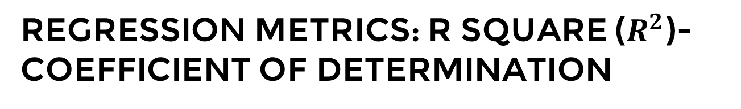

REGRESSION METRICS: R SQUARE ($R^{2}$)-COEFFICIENT OF DETERMINATION
R-square or the coefficient of determination represents the proportion of variance (of y) that has been explained by the independent variables in the model.
If $R^{2}=80$, this means that 80% of the increase in insurance cost is due to increase in the age of the applicant.
INSURANCE COST
AGE

Slide 17


REGRESSION METRICS: R SQUARE ($R^{2}$)-COEFFICIENT OF DETERMINATION
R-square represents the proportion of variance of the dependant variable (y) that has been explained by the independent variables.
R-square provides an insight of goodness of fit.
It gives a measure of how well unseen samples are likely to be predicted by the model, through the proportion of explained variance.
Maximum $R^{2}$ value is 1
A constant model that always predicts the expected value of y, disregarding the input features, will have an R² score of 0.0.
$$R^{2}=1−\frac{\sum_{i=1}^{n}{{\left(y_{i}−{\hat{y}}_{i}\right)}^{2}}}{\sum_{i=1}^{n}{{\left(y_{i}−\overline{y}\right)}^{2}}}$$

Slide 18
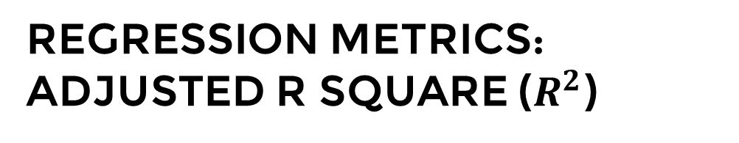

REGRESSION METRICS: ADJUSTED R SQUARE ($R^{2}$)
If $R^{2}=80$, this means that 80% of the increase in medical insurance cost is due to increase in applicant's age.
Let’s add another ‘useless’ independent variable, let’s say “color of car” to the Z-axis. (note that we are trying to predict the medical insurance cost and not the car insurance cost!)
Now $R^{2}$ increases and becomes: $R^{2}=85\%$
INSURANCE COST
COLOR OF APPLICANT’S CAR
AGE

Slide 19


REGRESSION METRICS: ADJUSTED R SQUARE ($R^{2}$)
One limitation of $R^{2}$ is that it increases by adding independent variables to the model which is misleading since some added variables might be useless with minimal significance.
Adjusted $R^{2}$ overcomes this issue by adding a penalty if we make an attempt to add independent variable that does not improve the model.
Adjusted $R^{2}$ is a modified version of the $R^{2}$ and takes into account the number of predictors in the model.
If useless predictors are added to the model, Adjusted $R^{2}$ will decrease
If useful predictors are added to the model, Adjusted $R^{2}$ will increase
$K$ is the number of independent variables and $n$ is the number of samples
$$R_{adjusted}^{2}=1−[\frac{\left(1−R^{2}\right)\left(n−1\right)}{n−k−1}]$$

Slide 20
ARTIFICIAL NEURAL NETWORKS FOR REGRESSION

Slide 21
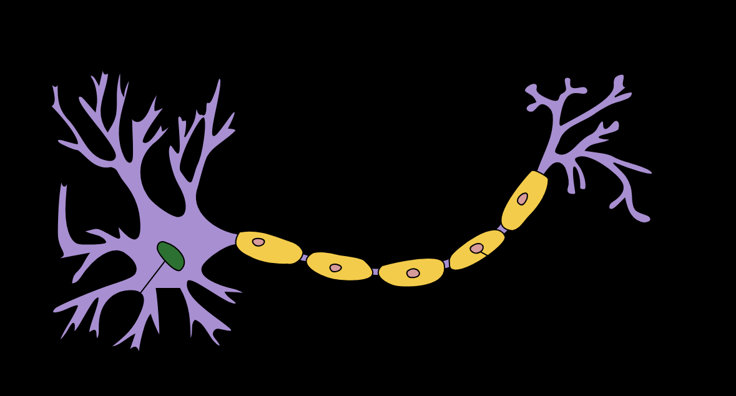
NEURON MATHEMATICAL MODEL
The neuron collects signals from input channels named dendrites, processes information in its nucleus, and then generates an output in a long thin branch called axon.
X1
W1
NEURON
X2
W2
W3
DENDRITES
X3
AXON
NUCLEAS

Slide 22








DO YOU REMEMBER OUR FIRST NEURON MODEL?
Bias allows to shift the activation function curve up or down.
Number of adjustable parameters = 4 (3 weights and 1 bias).
Activation function “F”.
b
$$X_{1}$$
$$W_{1}$$
F
$$W_{2}$$
INPUTS/INDEPENDENT VARIABLES
$$X_{2}$$
$$W_{3}$$
$$X_{3}$$
$$y=f(X_{1}W_{1}+X_{2}W_{2}+X_{3}W_{3}+b)$$

Slide 23
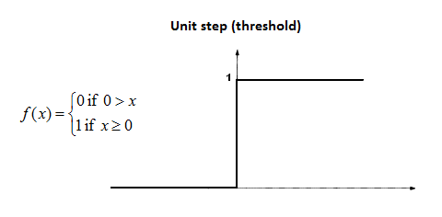










SINGLE NEURON MODEL IN ACTION!
Let’s assume an activation function of Unit Step.
The activation functions is used to map the input between (0, 1).
$$b=0$$
Input #1=1
$$X_{1}$$
$W_{1}$=0.7
F
$$X_{2}$$
$$W_{2}=0.1$$
Input #2=3
$$W_{3}=0.3$$
$$y=f\left(X_{1}W_{1}+X_{2}W_{2}+X_{3}W_{3}+b\right)$$
Input #3=4
$$X_{3}$$
$$y=f\left(1∗0.7+3∗0.1+4∗0.3\right)=f(2.2)$$
$$y=1 (because 2.2>0)$$

Slide 24
ACTIVATION FUNCTIONS

Slide 25
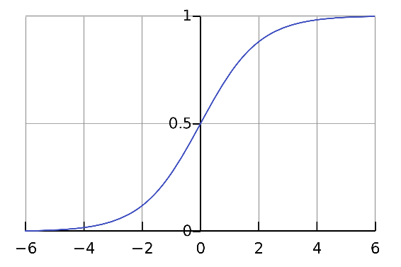
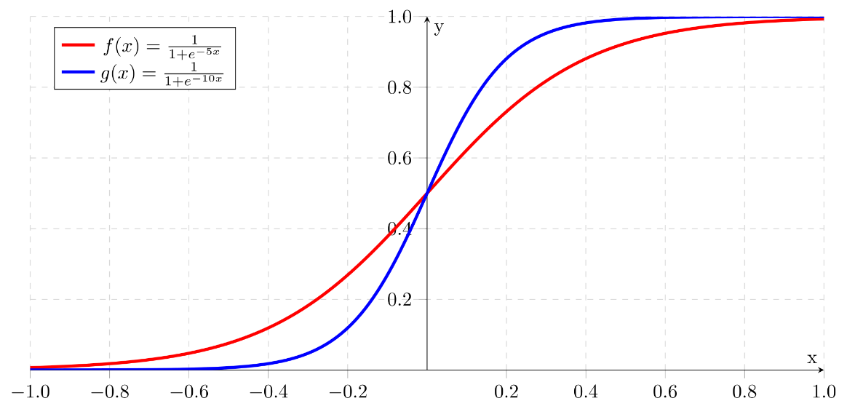
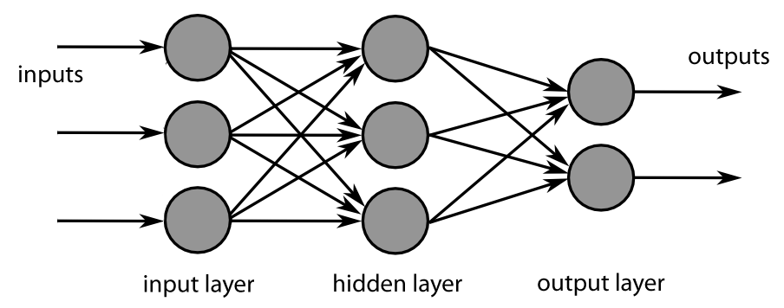
ACTIVATION FUNCTIONS
SIGMOID:
Takes a number and sets it between 0 and 1
Converts large negative numbers to 0 and large positive numbers to 1.
Generally used in output layer.
Photo credit: https://commons.wikimedia.org/wiki/File:Sigmoid-function.svg
Photo Credit: https://fr.m.wikipedia.org/wiki/Fichier:MultiLayerNeuralNetworkBigger_english.png
Photo Credit: https://commons.wikimedia.org/wiki/File:Logistic-curve.svg

Slide 26
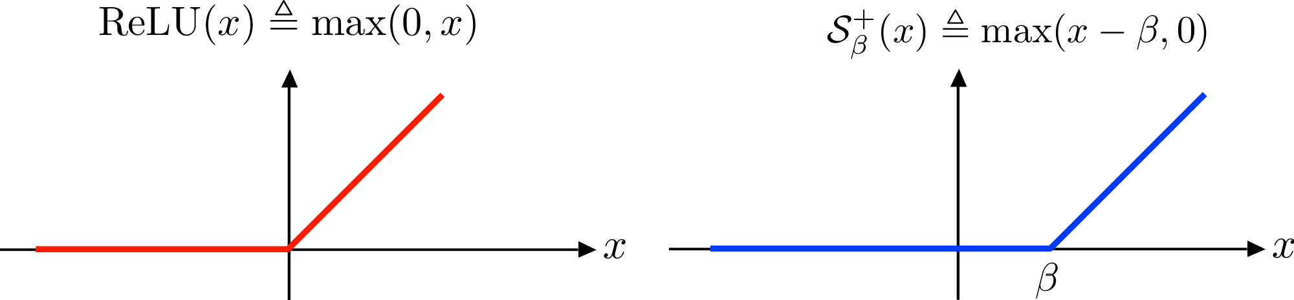
ACTIVATION FUNCTIONS
RELU (RECTIFIED LINEAR UNITS):
if input x < 0, output is 0 and if x > 0 the output is x.
RELU does not saturate so it avoids vanishing gradient problem.
It uses simple thresholding so it is computationally efficient.
Generally used in hidden layers.
Photo credit: https://commons.wikimedia.org/wiki/File:ReLU_and_Nonnegative_Soft_Thresholding_Functions.svg
Photo Credit: https://fr.m.wikipedia.org/wiki/Fichier:MultiLayerNeuralNetworkBigger_english.png

Slide 27
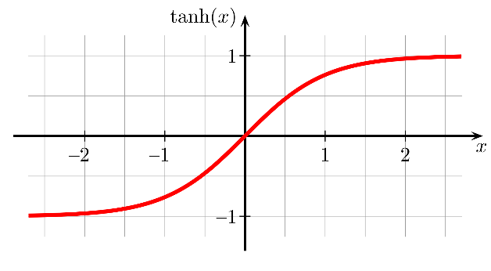
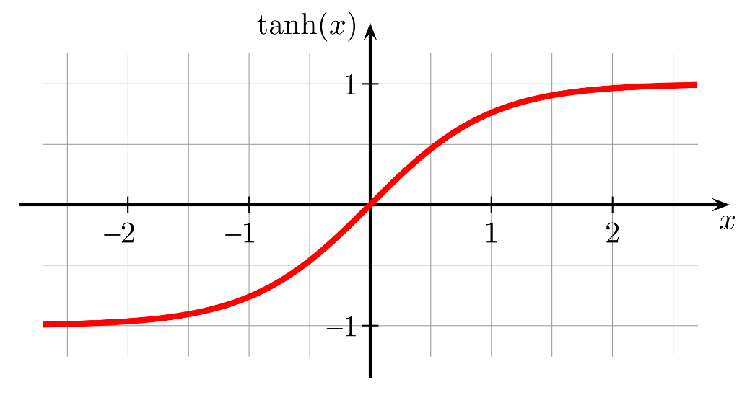
ACTIVATION FUNCTIONS
HYPERBOLIC TANGENT ACTIVATION FUNCTION:
“Tanh” is similar to sigmoid, converts number between -1 and 1.
Unlike sigmoid, tanh outputs are zero-centered (range: -1 and 1).
Tanh suffers from vanishing gradient problem so it kills gradients when saturated.
In practice, tanh is preferable over sigmoid.
Photo credit: https://commons.wikimedia.org/wiki/File:Hyperbolic_Tangent.svg
Photo Credit: https://fr.m.wikipedia.org/wiki/Fichier:MultiLayerNeuralNetworkBigger_english.png

Slide 28
MULTI-NEURON MODEL (MULTI-LAYER PERCEPTRON MODEL)

Slide 29
MULTI-LAYER PERCEPTRON NETWORK
The network is represented by a matrix of weights, inputs and outputs.
Total Number of adjustable parameters = 8:
Weights = 6
Biases = 2
P1
W1
W2
n1
a1
Matrix Representation
P2
∑
f
W3
P3
b1
P1
W1
W2
n2
a2
P2
∑
f
W3
P3
b2

Slide 30
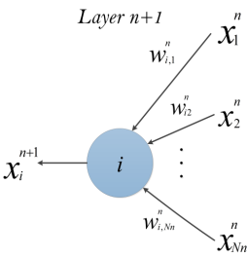
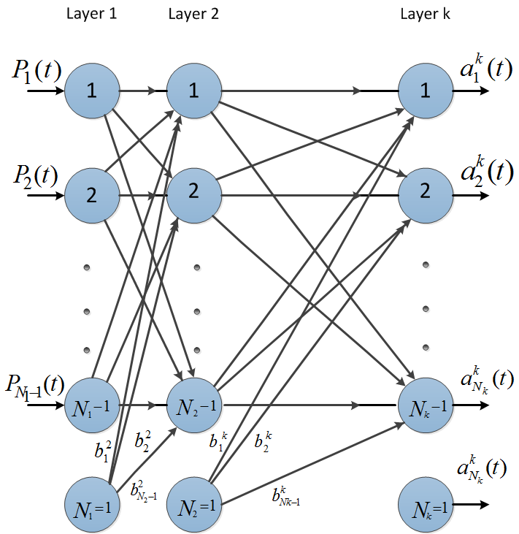



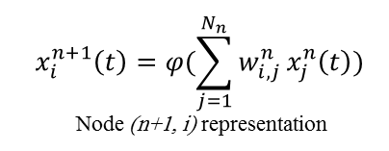
MULTI-LAYER PERCEPTRON NETWORK
Let’s connect multiple of these neurons in a multi-layer fashion.
The more hidden layers, the more “deep” the network will get.
$$x_{i}^{n+1}\left(t\right)=φ(\sum_{j=1}^{N_{n}}{w_{i, j}^{n}}x_{j}^{n}\left(t\right))$$
Node (n+1, i) representation
$$\left[\begin{matrix}\begin{matrix}W_{11} & W_{12} \\ W_{21} & W_{22}\end{matrix} & ⋯ & \begin{matrix}W_{1{, N}_{1}} \\ W_{2{, N}_{1}}\end{matrix} \\ ⋮ & ⋱ & ⋮ \\ \begin{matrix}W_{m−1,1} & W_{m−1,2} \\ W_{m,1} & W_{m,2}\end{matrix} & ⋯ & \begin{matrix}W_{m−1{, N}_{1}} \\ W_{m{, N}_{1}}\end{matrix}\end{matrix}\right]$$
Non-Linear Sigmoid Activation function
$$φ\left(w\right)=\frac{1}{1+e^{−w}}$$
m: number of neurons in the hidden layer
$N_{1}$: number of inputs

Slide 31
HOW DO ANNS TRAIN?

Slide 32

ANN TRAINING PROCESS
Predicted
Output
$$\hat{Y}$$
Desired (True) Output Y
Testing
inputs
X
Training
inputs
X
Error = $\hat{Y}−Y$
Update Network Weights

Slide 33
DIVIDE DATA INTO TRAINING AND TESTING
TRAINING DATASET
80%
Data set is generally divided into 80% for training and 20% for testing.
Sometimes, we might include cross validation dataset as well and then we divide it into 60%, 20%, 20% segments for training, validation, and testing, respectively (numbers may vary).
Training set: used for gradient calculation and weight update.
Validation set:
used for cross-validation which is performed to assess training quality as training proceeds.
Cross-validation is implemented to overcome over-fitting (over-training). Over-fitting occurs when algorithm focuses on training set details at cost of losing generalization ability.
Trained network MSE might be small during training but during testing, the network may exhibit poor generalization performance.
Testing set: used for testing trained network.
TESTING DATASET
20%
TRAINING DATASET
60%
VALIDATION DATASET
20%
TESTING DATASET
20%

Slide 34
GRADIENT DESCENT

Slide 35
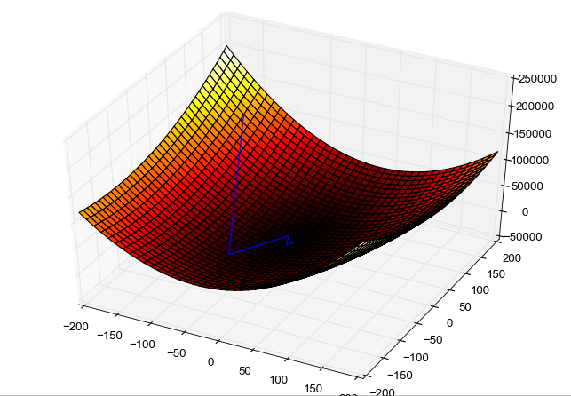
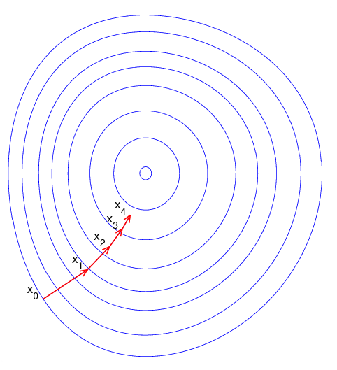
GRADIENT DESCENT
Gradient descent is an optimization algorithm used to obtain the optimized network weight and bias values
It works by iteratively trying to minimize the cost function
It works by calculating the gradient of the cost function and moving in the negative direction until the local/global minimum is achieved
If the positive of the gradient is taken, local/global maximum is achieved
Photo Credit: https://commons.wikimedia.org/wiki/File:Gradient_descent_method.png
Photo Credit: https://commons.wikimedia.org/wiki/File:Gradient_descent.png

Slide 36
LEARNING RATE
The size of the steps taken are called the learning rate
If learning rate increases, the area covered in the search space will increase so we might reach global minimum faster
However, we can overshoot the target
For small learning rates, training will take much longer to reach optimized weight values

Slide 37



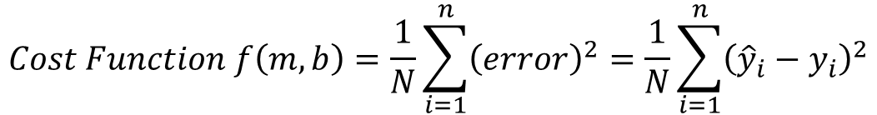
GRADIENT DESCENT
THESE ARE MY TRAINING DATA (INPUTS AND OUTPUT)
Let’s assume that we want to obtain the optimal values for parameters ‘m’ and ‘b’.
Training
inputs
X
Predicted
Output
$$\hat{Y}$$
Actual (True) Output Y
MACHINE LEARNING MODEL
$$y=b+m∗x$$
$$y=b+m∗x$$
GOAL IS TO FIND
BEST PARAMETERS
error = ${\hat{y}}_{i}−y_{i}$
We need to first formulate a loss function as follows:
Update Weights (parameters)
$$Cost Function f\left(m,b\right)=\frac{1}{N}\sum_{i=1}^{n}{{\left(error\right)}^{2}}=\frac{1}{N}\sum_{i=1}^{n}{{\left({\hat{y}}_{i}−y_{i}\right)}^{2}}$$

Slide 38

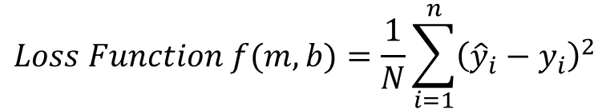
GRADIENT DESCENT
$$Loss Function f(m,b)=\frac{1}{N}\sum_{i=1}^{n}{{\left({\hat{y}}_{i}−y_{i}\right)}^{2}}$$
OPTIMAL POINT
GLOBAL MINIMUM
GRADIENT DESCENT WORKS AS FOLLOWS:
Calculate the gradient (derivative) of the Loss function $\frac{∂loss}{∂w}$
Pick random values for weights (m, b) and substitute
Calculate the step size (how much are we going to update the parameters?)
$Step size =learning rate∗gradient= α∗\frac{∂loss}{∂w}$
Update the parameters and repeat
$new weight = old weight –step size$
$w_{new}=w_{old }−α∗\frac{∂loss}{∂w}$
Sum of Squared Residuals
Parameters (m, b)
*Note: in reality, this graph is 3D and has three axes, one for m, b and sum of squared residuals

Slide 39
BACKPROPAGATION

Slide 40
BACK PROPAGATION
Backpropagation is a method used to train ANNs by calculating gradient needed to update network weights.
It is commonly used by the gradient descent optimization algorithm to adjust the weight of neurons by calculating the gradient of the loss function.
STEP 1: FORWARD PROPAGATION
STEP 2: ERROR CALCULATION
STEP 4: WEIGHT UPDATE
STEP 3: BACK PROPAGATION

Slide 41
BACK PROPAGATION
Backpropagation Phase 1: propagation
Propagation forward through the network to generate the output value(s)
Calculation of the cost (error term)
Propagation of output activations back through network using training pattern target in order to generate the deltas (difference between targeted and actual output values)
STEP 1: FORWARD PROPAGATION
STEP 2: ERROR CALCULATION
STEP 4: WEIGHT UPDATE
STEP 3: BACK PROPAGATION

Slide 42
BACK PROPAGATION
Phase 2: weight update
Calculate weight gradient.
A ratio (percentage) of the weight's gradient is subtracted from the weight.
This ratio influences the speed and quality of learning and called learning rate. The greater the ratio, the faster neuron train, but lower ratio, more accurate the training is.
STEP 1: FORWARD PROPAGATION
STEP 2: ERROR CALCULATION
STEP 4: WEIGHT UPDATE
STEP 3: BACK PROPAGATION

Slide 43
BACK PROPAGATION ADDITIONAL READING MATERIAL
“Backpropagation neural networks: A tutorial” by Barry J.Wythoff
“Improved backpropagation learning in neural networks with windowed momentum”, International Journal of Neural Systems, vol. 12, no.3&4, pp. 303-318.

